Slide 1
Robotics Lab
Lecture 4: Inverse kinematics
Damascus University 2019-2020

Slide 2
Inverse kinematic Solutions
Geometry.
Algebra.

Slide 3
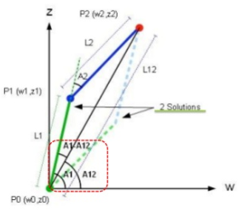
Inverse kinematic by Geometry

Slide 4
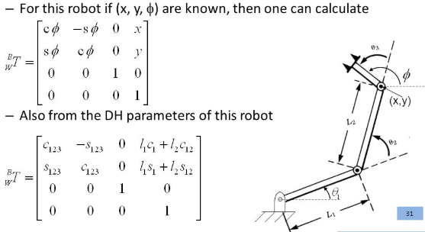
Inverse kinematic by Algebra

Slide 5
Matlab code
dh = [0 0 10 0
0 0 9 0]
r = SerialLink(dh)
P = transl(0,14,0)
q = r.ikine(P,'mask',[1 1 0 0 0 0])
r.plot(q)
qdeg = rad2deg(q)

